Slide 1
CS2033a/b Multimedia and Communications II Lecture 7 Working with CSS Styles Vivi Tryphonopoulos

Slide 2

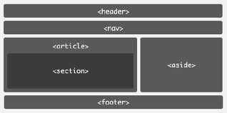
CSS CONCEPTS : Working With CSS Styles
Now build a website .... the “Developer” way ... Use CSS Styles
Next let’s look at
Using CSS Styles
Using CSS Styles
Control the appearance of text
Control the layout
Identify box elements using Div IDs
Notes:
16px may look great on a desktop monitor, but on a mobile device 16px is huge
If we use 1em , telling device to set font to 100% of its default font size which is one size on the desktop and another size on a mobile device

Slide 3
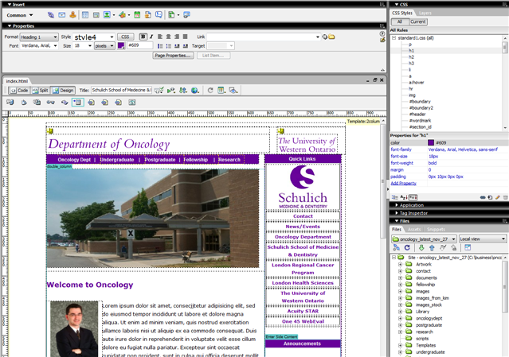
Work with Styles from the side CSS panel
Activate CSS panel via menu Window > CSS Styles

Slide 4
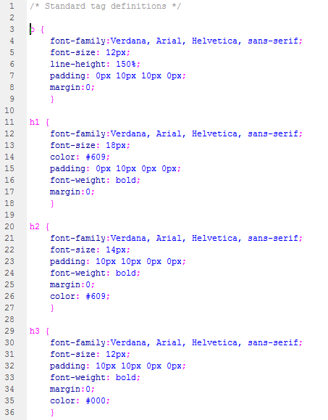

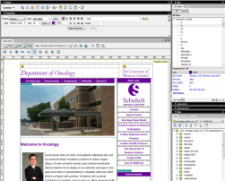


CSS CONCEPTS : Working With CSS Styles
Using CSS Styles
CSS is a collection of formatting rules
Control the appearance of text content on webpages
Objective: consistency of appearance across webpages within website & across the website
→ Store CSS styles in:
Each webpage
External Style Sheet
Text formatting (typeface, size, color, weight etc)
alignment, indentation, and paragraph spacing
Links appearance – underlining, hovering, color
Bullet appearance
Page background color
Specific fonts for certain page elements
Etc.
Notes:
Available since 1996, but browser support was not there. With advent of CSS 2.0, and IE 6 Netsape 6+ Opera 6+), it has been more practical to use style sheets.

Slide 5
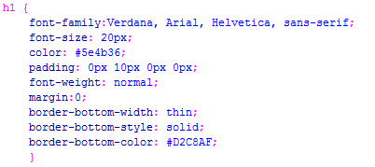
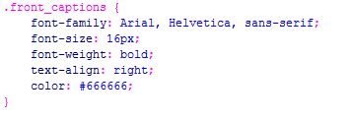
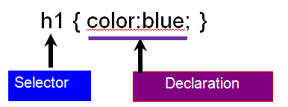
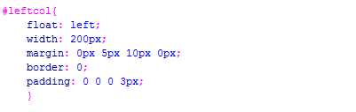

CSS CONCEPTS : Working With CSS Styles
Tag Selector
Style Selector types:
Tag (Type)
Class
ID
Compound (older versions Advanced Selectors)
Class Selector
Selector Definition:
ID Selector
Property: value
Compound
Notes:
16px may look great on a desktop monitor, but on a mobile device 16px is huge
If we use 1em , telling device to set font to 100% of its default font size which is one size on the desktop and another size on a mobile device

Slide 6
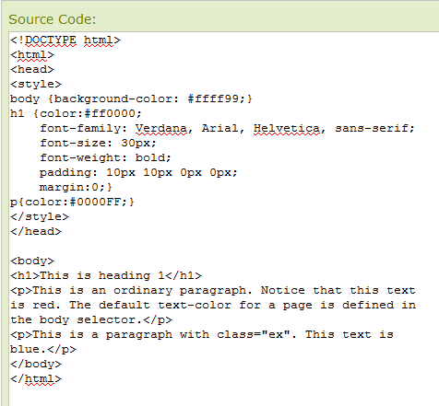
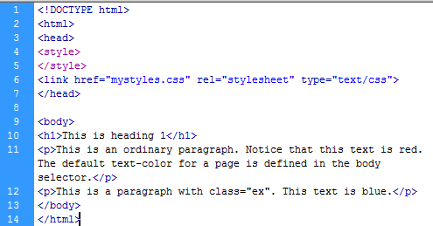
Placement of Selector definitions(declaration)
Internal to webpage
Stored in an external stylesheet (.css)
Inline (not desired – style inside actual tag) <p style="color:sienna;margin-left:20px">This is a paragraph.</p>
Internal to a webpage:
Each selector is defined in <head> and <style> section of your webpage (html)
Call to the definition is in the body section of the webpage.
Limitation to that page
External stylesheet:
Stylesheet extension .css
Each selector is defined in .css file
But in <head> section there is a link to css file but not in <style> section
Call to the definition is in the body section of the webpage.
Advantages:
make a change to the stylesheet and every page linked to it will change.
Can link to more than 1 stylesheet
Notes:
16px may look great on a desktop monitor, but on a mobile device 16px is huge
If we use 1em , telling device to set font to 100% of its default font size which is one size on the desktop and another size on a mobile device

Slide 7
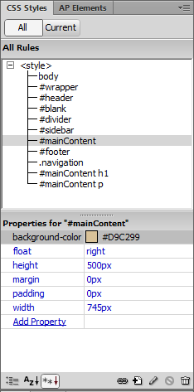
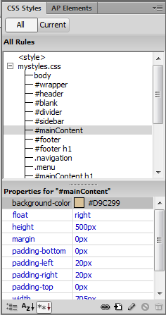
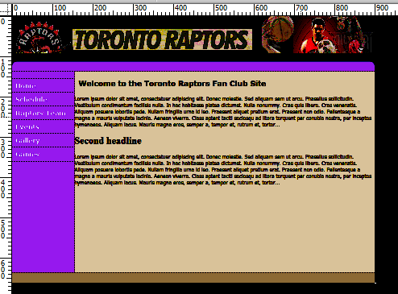
CSS CONCEPTS : Working With CSS Styles
In Dreamweaver, the CSS panel
How can you tell if the CSS Styles associated with a webpage is embedded into the webapge itself or external stylesheet is used?
Attach a CSS stylesheet
Create a New Rule Create a new Stylesheet
Notes:
16px may look great on a desktop monitor, but on a mobile device 16px is huge
If we use 1em , telling device to set font to 100% of its default font size which is one size on the desktop and another size on a mobile device

Slide 8
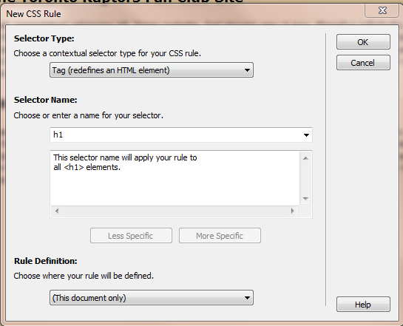
CSS CONCEPTS : Working With CSS Styles
Tag Selector
So when do we use these selectors?
Tag (Type)
Class
ID
Compound
To add a new style → Add a New Rule Choice: →In doc or external stylesheet
Class Selector
ID Selector
Compound
Notes:
16px may look great on a desktop monitor, but on a mobile device 16px is huge
If we use 1em , telling device to set font to 100% of its default font size which is one size on the desktop and another size on a mobile device

Slide 9
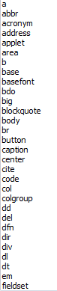
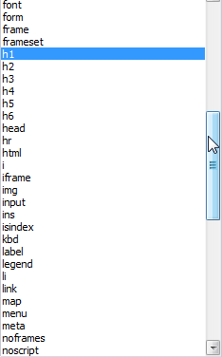
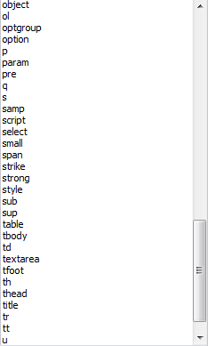
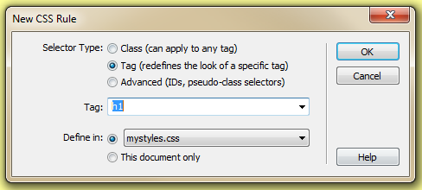

CSS Styles :
Tag Selector
Redefining (override default) the formatting characteristics/attributes for a particular HTML tag
Tag (Type) selector
Headings h1, h2, h3, h4, h5, h6
Paragraph <p>
Ordered lists look <ol> <ul>
Horizontal ruler <hr>
Body <body>
Images <img>
Table <table>
Notes:
16px may look great on a desktop monitor, but on a mobile device 16px is huge
If we use 1em , telling device to set font to 100% of its default font size which is one size on the desktop and another size on a mobile device

Slide 10
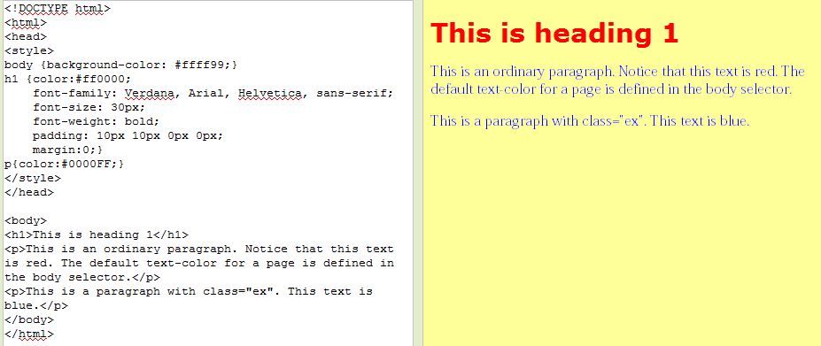
CSS Styles :
Tag Selector
In this example:
Redefining (override default) the formatting for:
Body, h1, and p
Notes:
16px may look great on a desktop monitor, but on a mobile device 16px is huge
If we use 1em , telling device to set font to 100% of its default font size which is one size on the desktop and another size on a mobile device

Slide 11
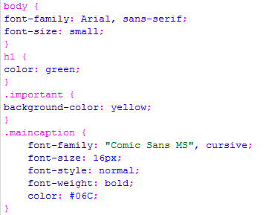
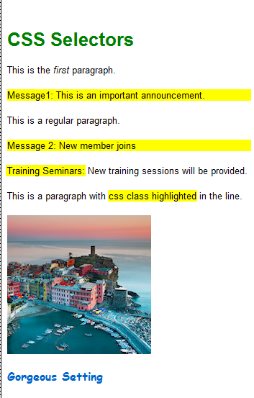
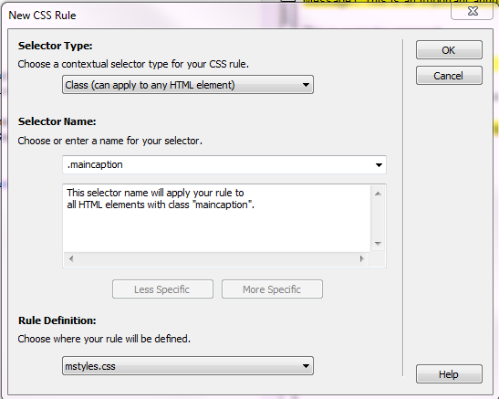
Class Selector
Create a customized style with a set attributes without affecting HTML tags.
These styles can be applied to any elements on your webpage
You can use them repeatedly over and over within the page or across the entire site (if ext stylesheet)
Class selector names must begin with a period (.)
To create the new class rule
Notes:
16px may look great on a desktop monitor, but on a mobile device 16px is huge
If we use 1em , telling device to set font to 100% of its default font size which is one size on the desktop and another size on a mobile device

Slide 12
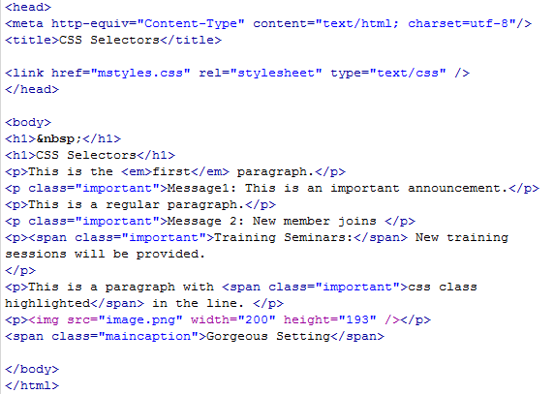
Class Selector
In this example you have 2 classes: .important and .maincaption
Notes:
16px may look great on a desktop monitor, but on a mobile device 16px is huge
If we use 1em , telling device to set font to 100% of its default font size which is one size on the desktop and another size on a mobile device

Slide 13
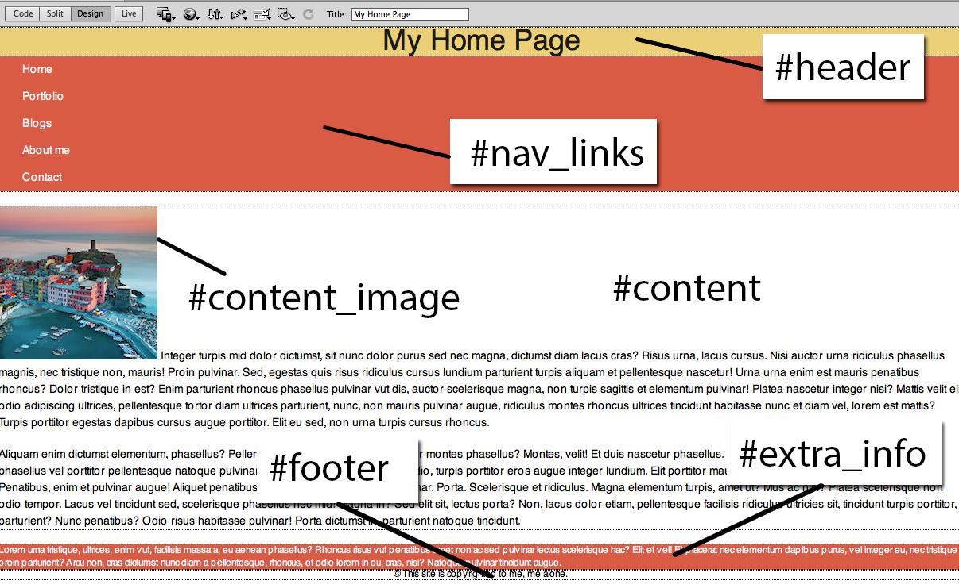
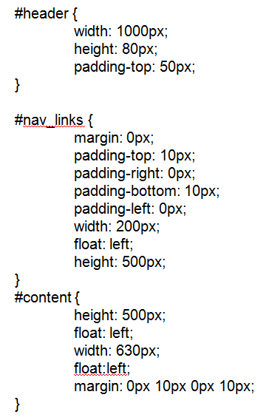
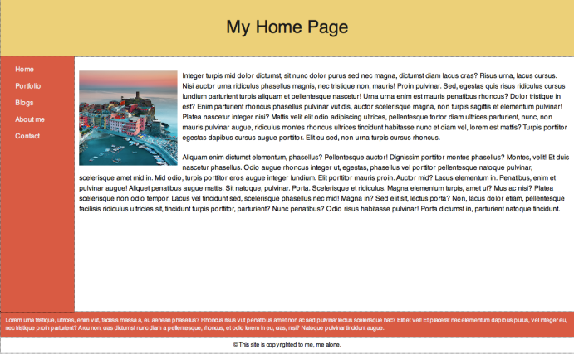
ID Selector
ID selector names must begin with a number sign (#)
Identifies ONE element that can only be used once in a webpage
It is a “unique” identifier to an element
→analogous to ID
= A person’s identification (ID) is unique to one person
IDs most commonly used for layouts:
One banner per page (#header)
One menu per page (#nav_links)
One content per page (#content)
One footer per page (#footer)
Etc.
Set attributes to each ID to make it look like this
Notes:
16px may look great on a desktop monitor, but on a mobile device 16px is huge
If we use 1em , telling device to set font to 100% of its default font size which is one size on the desktop and another size on a mobile device

Slide 14
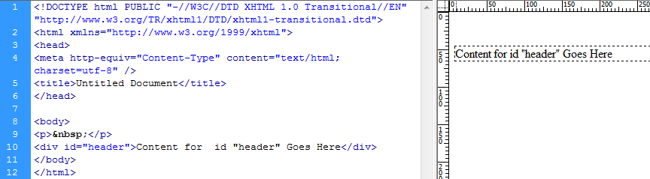
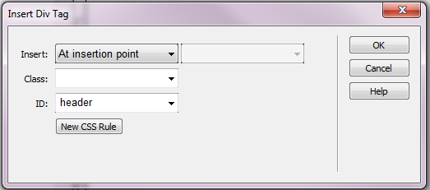
ID Selector:
To set up layout → 2 steps: Create and Assign
Step 1: Create the unique identifier using box model approach
Insert > Layout Objects > Div Tag Enter an ID selector name
If press Ok then proceeds to create the box → no attributes get assigned yet
If click on New CSS Rule → dialog box opens → can assign attributes (next slide)
Notes:
16px may look great on a desktop monitor, but on a mobile device 16px is huge
If we use 1em , telling device to set font to 100% of its default font size which is one size on the desktop and another size on a mobile device

Slide 15
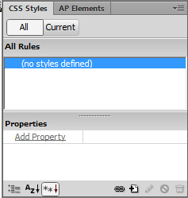
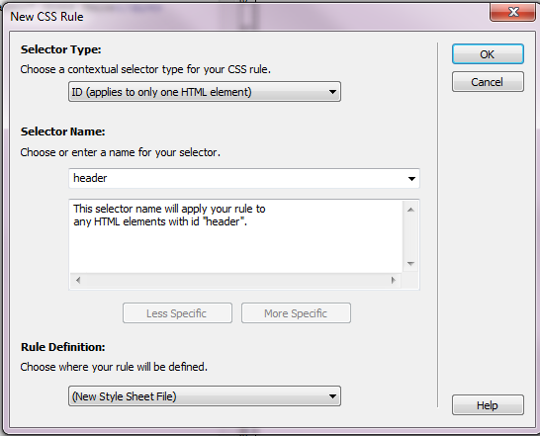
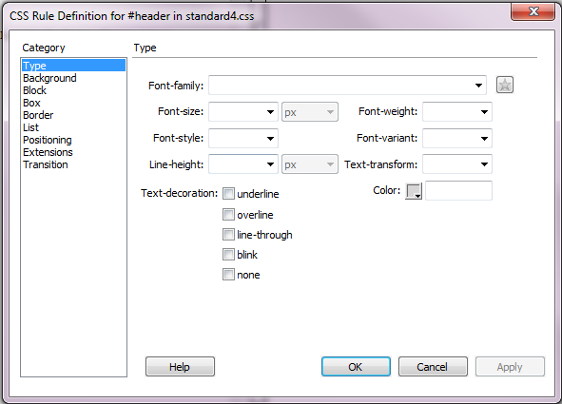
ID Selector:
Step 2: Assign the attributes to the ID selector #header
How?
Can continue from last slide by pressing New CSS Rule
Or Format > CSS Styles > New Rule
Or from CSS panel, click on icon
Start assigning the attributes to the ID #header
Notes:
16px may look great on a desktop monitor, but on a mobile device 16px is huge
If we use 1em , telling device to set font to 100% of its default font size which is one size on the desktop and another size on a mobile device

Slide 16
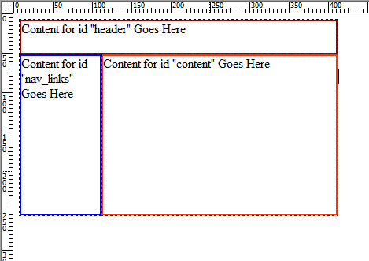
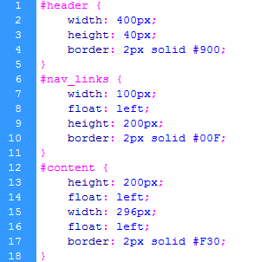
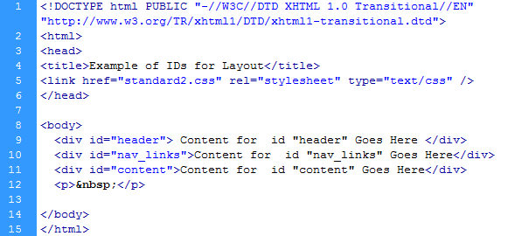
Simplest Div ID for layout:
Using box model … bare bones
Using the bare bones:
Box width, height, border Float: to get positioning

Slide 17
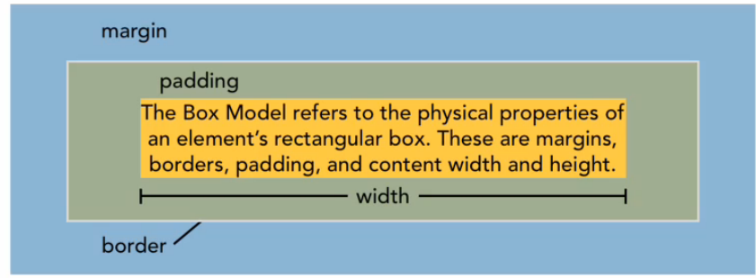
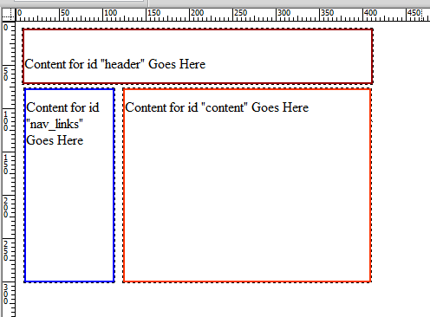
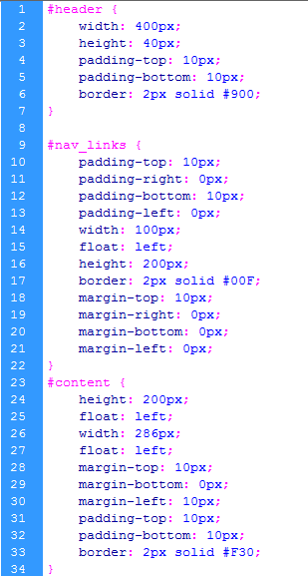
Simplest Div ID for layout:
One step further
…. Added padding, margins

Slide 18
Compound Selectors (aka Contextual Selectors)
(older DW versions called Advanced Selectors)
Control:
Hyperlink appearances and behavior
Two or more style rules to create a style definition that displays only when one style is contained within another.
a:link, a:visited, a:hover,a:active
#maincontent h1 {color: #ff0000;}
#maincontent a:link {color:#990000 text-decoration:none;}
.myclass b {color: #990000;} (red color)
Let’s look at them more closely
Notes:
16px may look great on a desktop monitor, but on a mobile device 16px is huge
If we use 1em , telling device to set font to 100% of its default font size which is one size on the desktop and another size on a mobile device

Slide 19
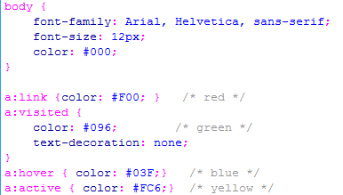

Compound Selectors (aka Contextual Selectors)
Control:
Hyperlink appearances and behaviour
Known as “pseudoclasses”, “advanced selectors”
Hyperlinks have 4 states:
a:link Default display of link
a:visited After link has been visited
a:hover When cursor hovers over link a:active When mouse clicks on link
MUST BE DEFINED IN ORDER
in stylesheet
Text-decoration→ Underline style
Tip: for underline style
a:link setting overrides any setting with a:visited
(see example above) link and visited will show with underlining
default
Notes:
16px may look great on a desktop monitor, but on a mobile device 16px is huge
If we use 1em , telling device to set font to 100% of its default font size which is one size on the desktop and another size on a mobile device

Slide 20
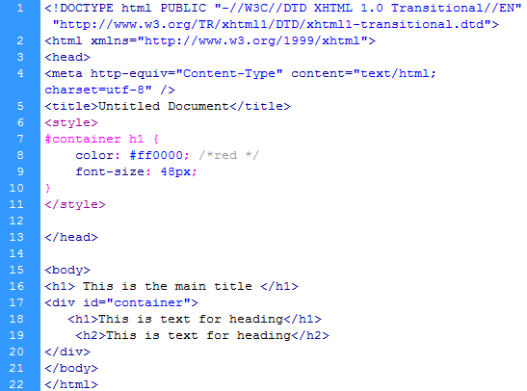
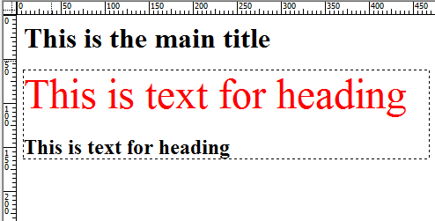
Compound Selectors
Two or more style rules to create a style definition that displays only when one style is contained within another. Example: # container h1 → if text is formatted with Heading 1 AND is inside of a div #container → then give it red color, font size 48px
Notes:
16px may look great on a desktop monitor, but on a mobile device 16px is huge
If we use 1em , telling device to set font to 100% of its default font size which is one size on the desktop and another size on a mobile device

Slide 21
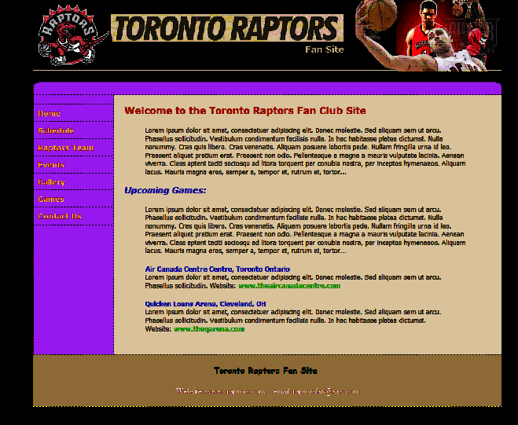
Compound Selectors
Two or more style – Another example
#footer a:link {color=#F00;}
#footer a:visited {color=#00F;}
#footer a:hover {color=#0F0;}
#sidebar a:link {color=#222222;}
#sidebar a:visited {color=#222222;}
#sidebar a:hover {color=#0F0;}
#maincontent
#maincontent a:link {color=#555555;}
# maincontent a:visited {color=#555555;}
# maincontent a:hover {color=#0F0;}
#sidebar
#footer
Notes:
16px may look great on a desktop monitor, but on a mobile device 16px is huge
If we use 1em , telling device to set font to 100% of its default font size which is one size on the desktop and another size on a mobile device

Slide 22
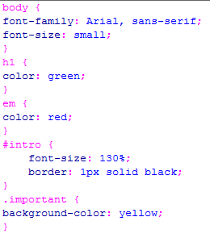
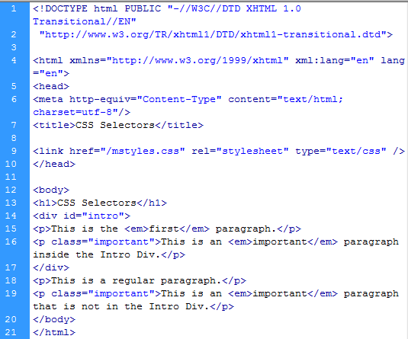
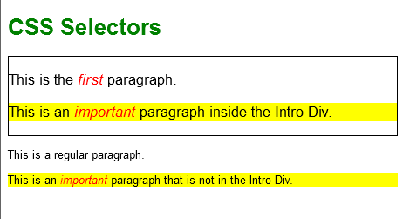
CSS Styles :
All together:
Tags, Classes, IDs
Notes:
16px may look great on a desktop monitor, but on a mobile device 16px is huge
If we use 1em , telling device to set font to 100% of its default font size which is one size on the desktop and another size on a mobile device

Slide 23
This week’s lab, you are working on CSS Styles and all using Dreamweaver CSS panel

